Slide 1
Response essay

Slide 2
How to compose a response essay
Before writing your own essay:
  Please make sure your watch the video; it’s very helpful
  Sample essay from past year is available on 2nd class page (the webpage your download your listening VOA passages)

Slide 3
Your essay Grade layout
FORMAT
STORY
STRUCTURE
LANGUAGE

Slide 4
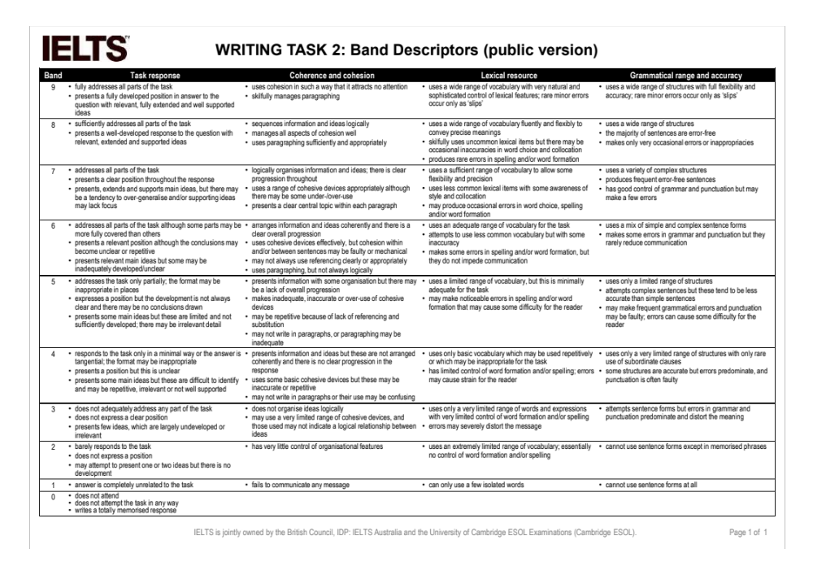
A sample writing evaluation for your reference

Slide 5
Common mistakes from the past – red flags!
Thesis statement missing: what’s this essay about, what’ your point of view for Lin’s idea in general? (para 1 should state out clearly)
Summary of book and author background missing or TOO much (P1)
Your essay should NOT only be a summary of lin’s point – that’s not a response essay
Summary of author’s point missing
Mixing book summary and own argumentation together (hard to tell)
Tone of writing: formal; not a speech
Logic flow: keywords to link is missing
Need a title, and should be creative
Punctuation mistakes:
  No <<>> punctuation in English, but ‘’ instead
  No …… but …
Plagiarism will lead to your grade of 0: not only words, but also idea; compose your own work

Slide 6
Common Language mistakes
Tense – double check for the whole passage
Sentence fragmented
Consistency – tense, and subject

